Slide 1
Java ca Club app for booking
SA46 Team 3
Chit Su Shine | Hsu Yee Phyo | Zhang Li Fu | Joel Fong | Zhang Jie Dong

Slide 2

architecture
Dispatch Servlet
Validator
JPA
Repo
Service
Controller
C
C
Model
M
M
DB
C
Service
Impl
Views

Slide 3
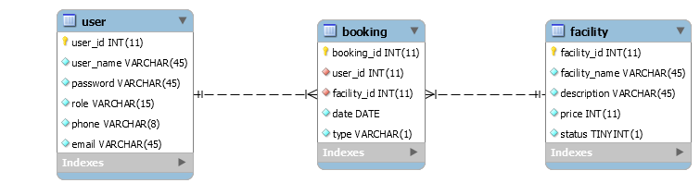
Data model

Slide 4




Team contribution
Database
Member registration
Manage bookings (RUD)
Booking history
Admin manage users
Admin manage members
Search function for facilities & current bookings & booking history for admin & members
Created project template
Configured project
Integration
Booking feature for Admin & Member
Manage Facilities
Login/Logout/Edit Profile
Debugging
Overseeing logic flow
Database
Admin manage booking
Admin booking history
PPT slides
Testing
Hsu Yee Phyo
Zhang Li Fu
Chit Su Shine
Joel Fong

Slide 5







Project experience – Challenges & process
Smallest group in SA46
Difficulties in mapping
Github
Integration
Unfamiliar with annotations
Deciding how to distribute work
Writing custom Queries
Java Noobs

Slide 6

Lessons learnt
Debugging in Spring MVC
Familiarity with Java exception errors
Mapping model classes
Time management with minimal resources
Designing database with foreign keys
Passing parameters from control to view, vice versa
Syntax - Java / Spring MVC / JSTL / JQuery / Expressions

Slide 7
Look out for
Code demo must walk through aspects:
Layering
Framework Usage
Data Access
Quality of JSP Pages
A decent exception management
Marked on these attributes:
a. Mandatory Use Cases
b. Screen flow
c. Business Rules and Validation
d. Exception Handling
e. Test Cases (both good and bad)

